Slide 1


Slide 2
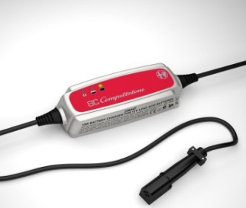
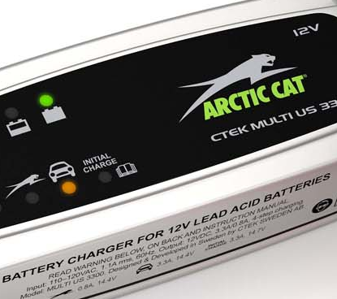
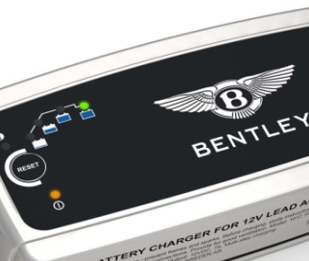




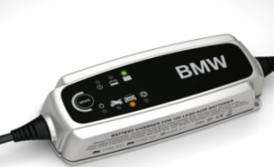
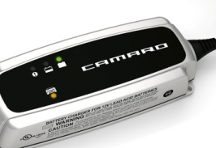
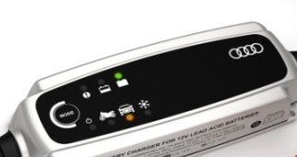
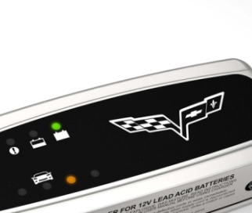
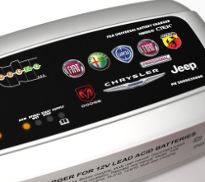
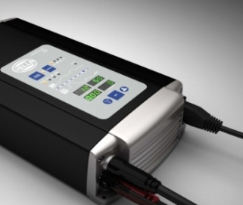

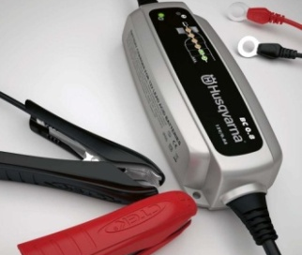
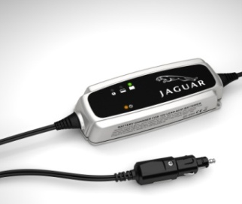
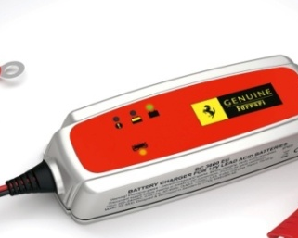




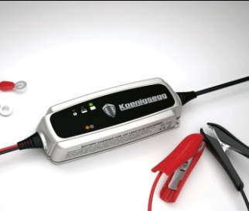
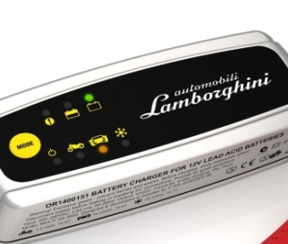
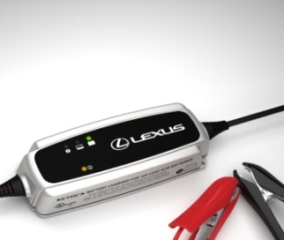
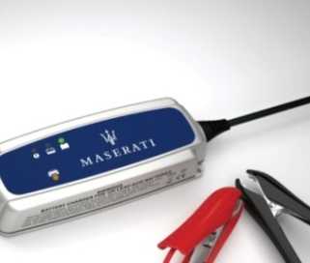
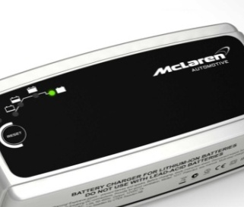
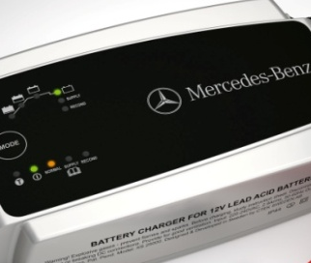





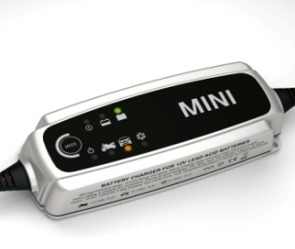
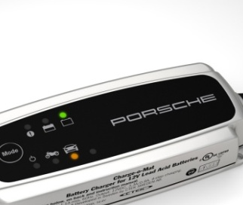
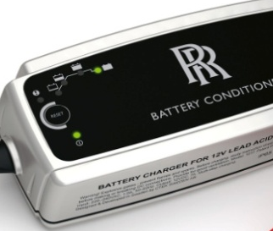
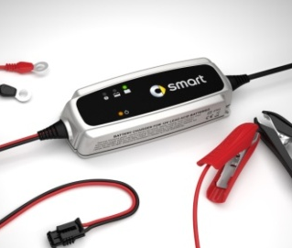
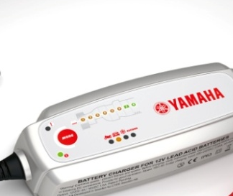





OEM-partners February 2012

Slide 3
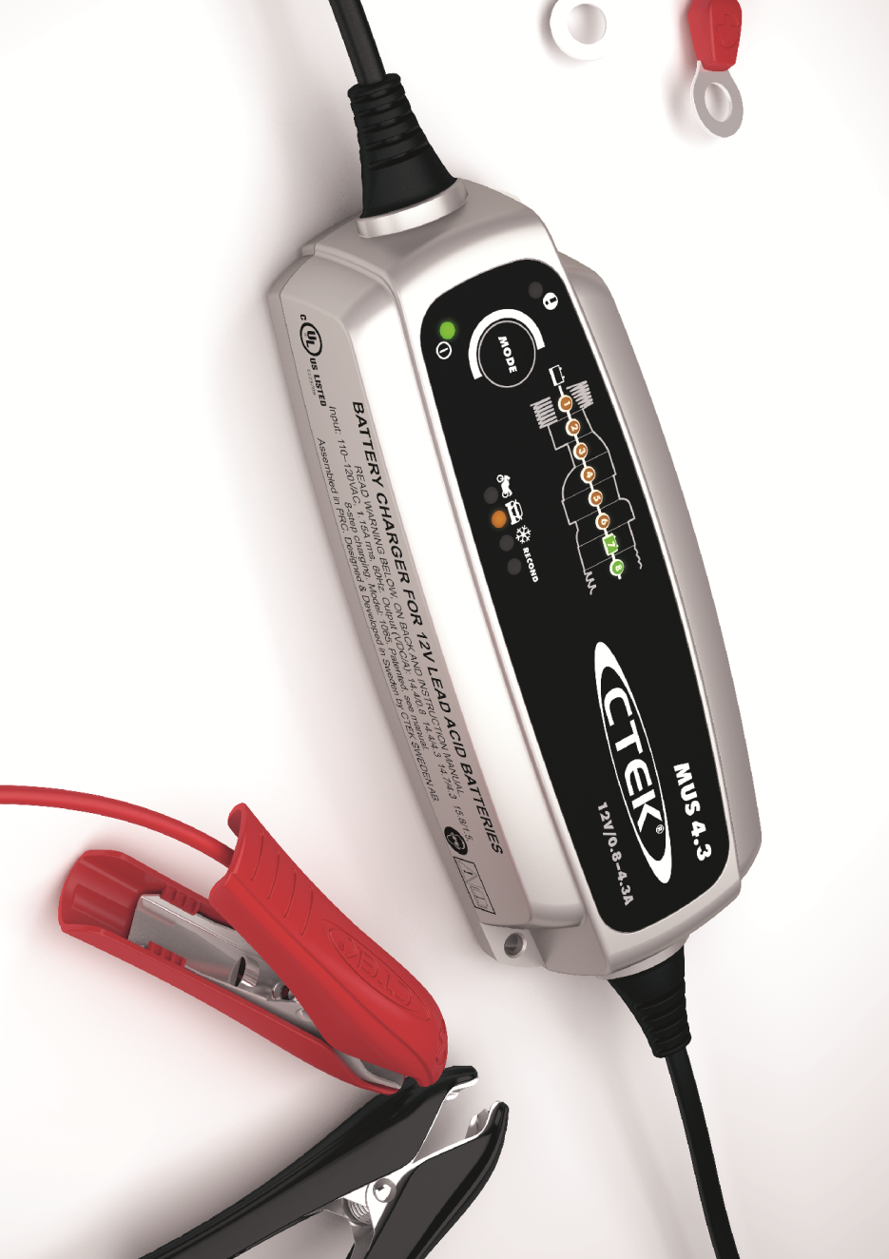
CTEK Technology Promise
The safest, most effective way to
  Recover batteries
  Charge batteries
  Maintain batteries
Maximise battery life
Reduce operator costs
Ensure vehicle reliability

Slide 4
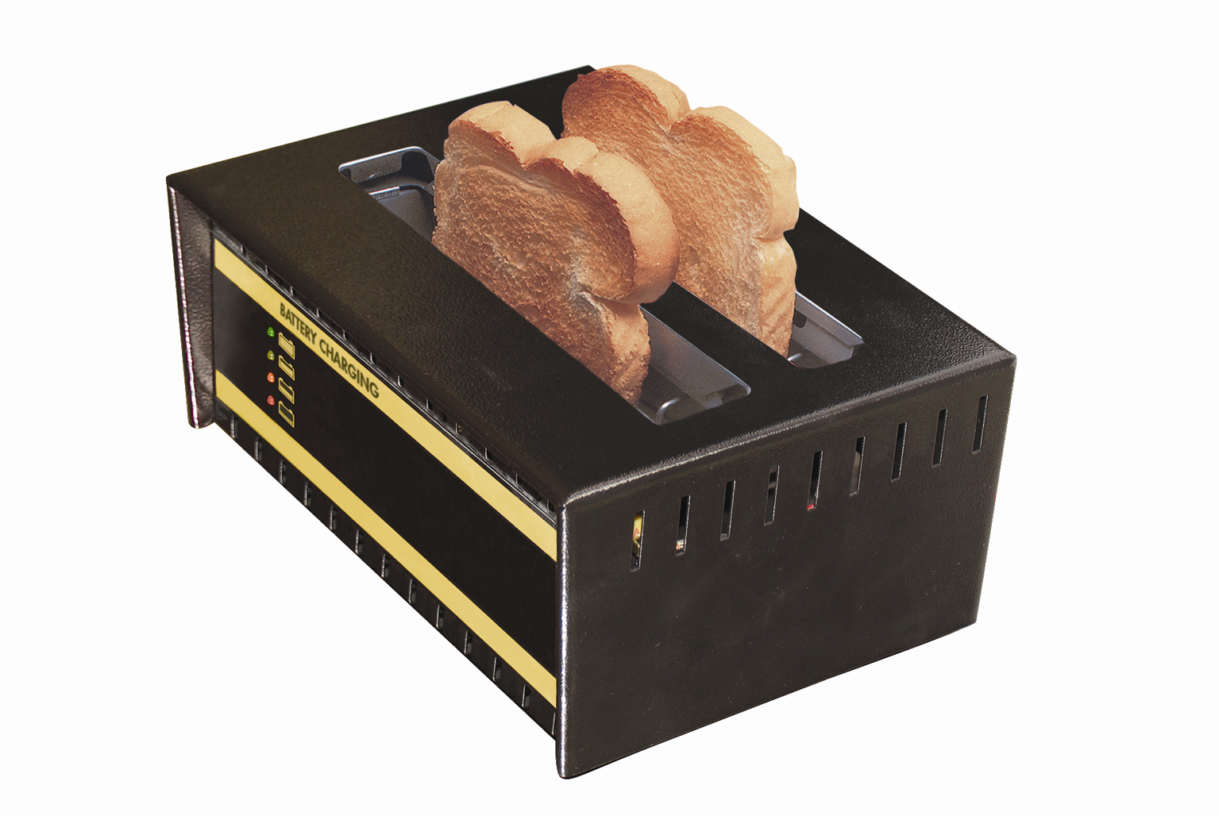
Battery Charger or Toaster?

Slide 5
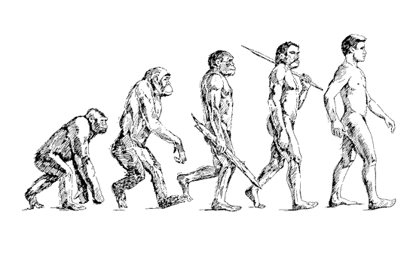

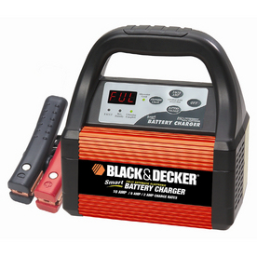
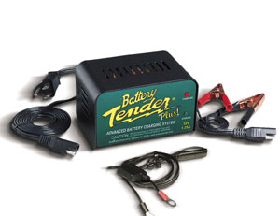
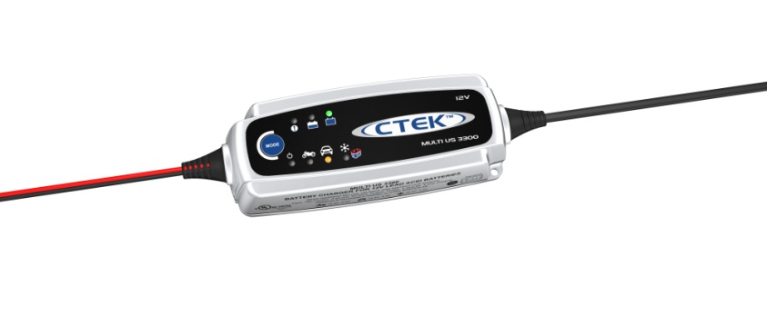
Battery Charger Evolution
Linear Basic Linear Automatic Intelligent Intelligent Multi Stage

Slide 6
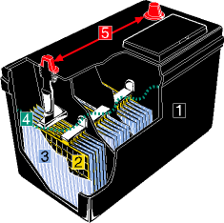
Basic Battery Construction
Batteries are made of five basic components:
  A resilient plastic container. (1)
  Positive (lead dioxide)and negative (sponge lead) plates.(2)
  Plate separators.(3)
  Electrolyte, a solution of sulfuric acid and water ‘battery acid’. (4)
  Terminal Posts; the connection point between the battery and whatever it powers. (5)

Slide 7
Most warranty returns are just undercharged!
178 returns evaluated

Slide 8
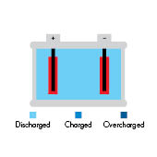
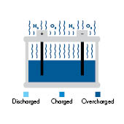
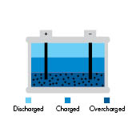
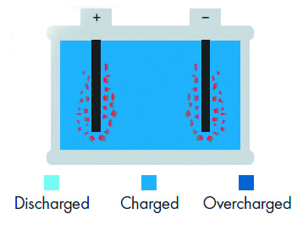
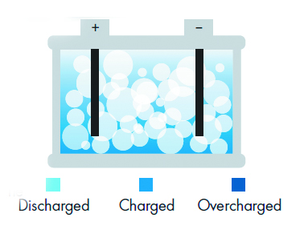
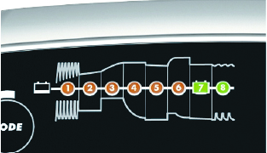
Battery Problems and Solutions
Sulfation
Overcharge
Stratification
CTEK SOLUTIONS
De-sulfation
Charge Control
Recondition
CTEK SOLUTIONS

Slide 9
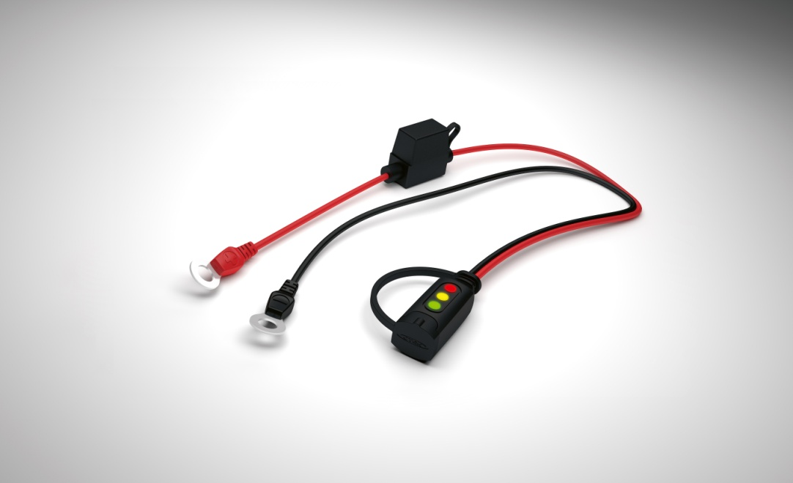
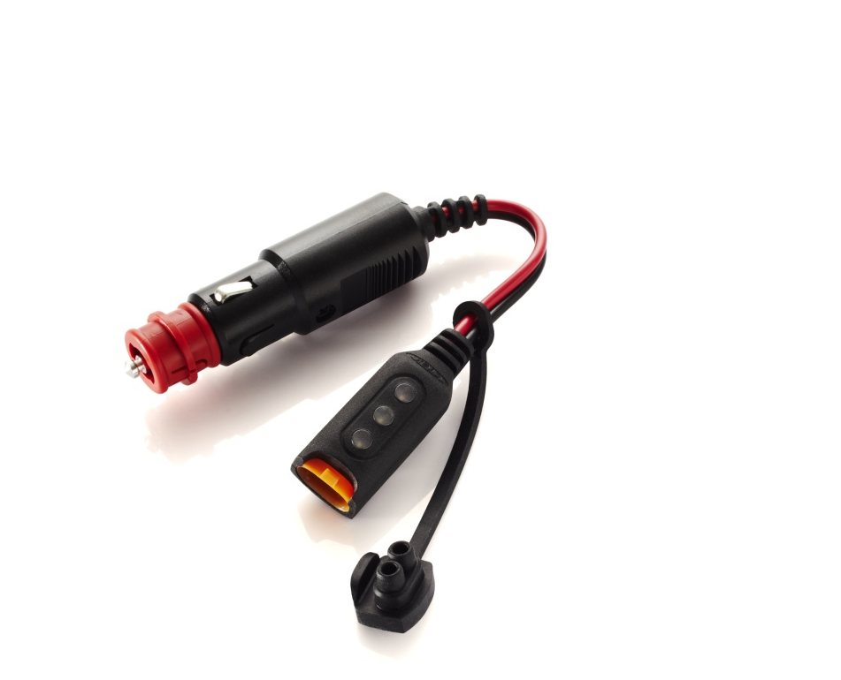
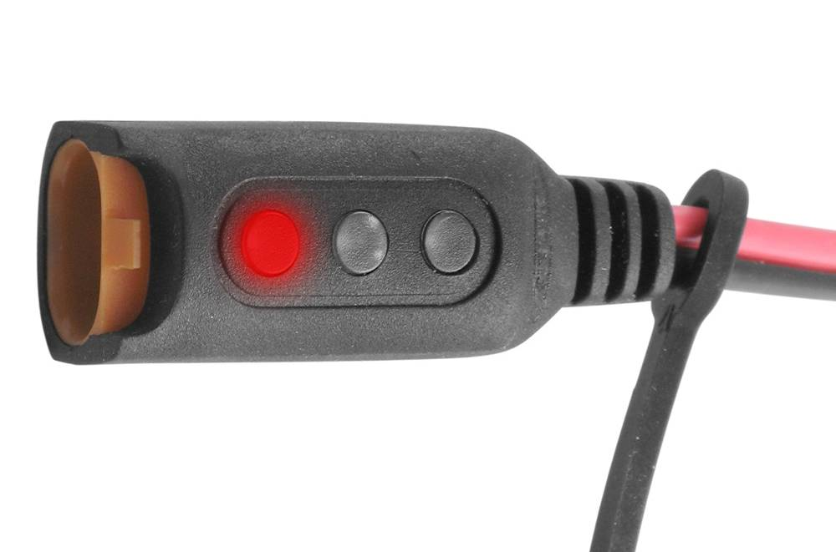
Award-winning Accessories
TattleTail Battery Status Indicator
Constant indication of batteries state of charge through L.E.D. display! The CTEK Chargers then plug directly into the Comfort Indicator

Slide 10
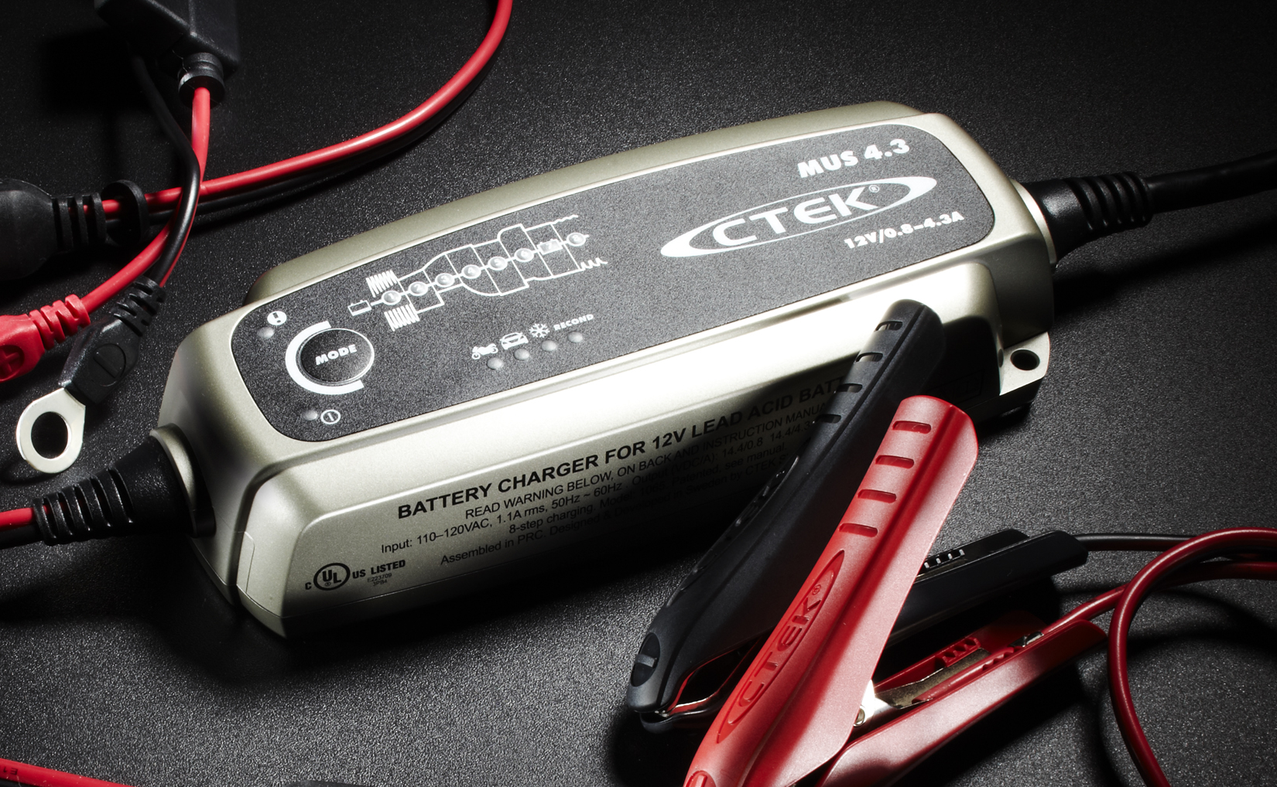
Connect and forget!
Worry-free operation
Maximized battery life & capacity
Easy-to-use
Multiple applications
Reliable & Waterproof
Sealed Design
Reconditions
Discharged Batteries
Multiple Connection
Options
Safe on Vehicle
Electronics:
Surge Protected
Perfect for AGM & GEL
Optima/Odyssey
batteries
User-Friendly,
Foolproof Modes
Unmatched Safety Features:
Spark, Short Circuit & Reverse
Polarity Protected

Slide 11
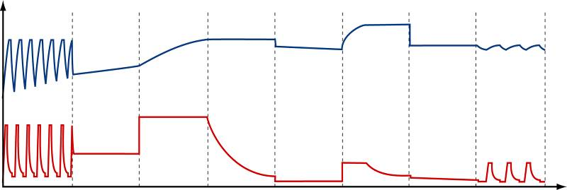
8 Steps to Perfect Batteries
Desulphation
Soft Start
Bulk
Absorption
Analyze
Recondition
Float
Pulse

