Slide 1
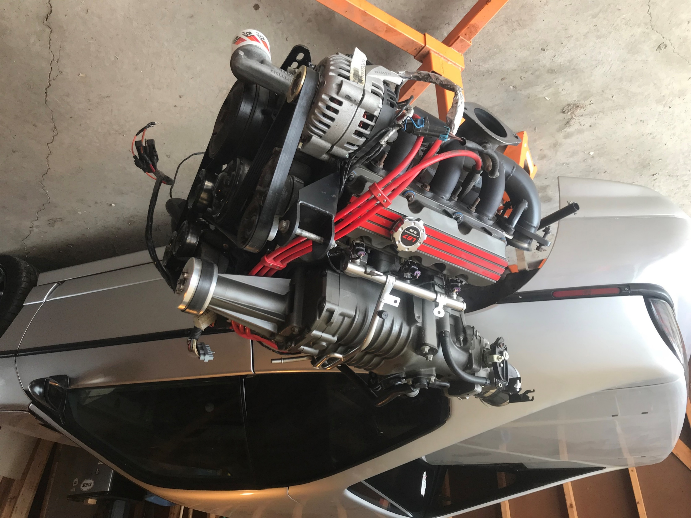
A Guide to 3800 Swap Your Fiero
Presented by:
Tim Jarrell

Slide 2
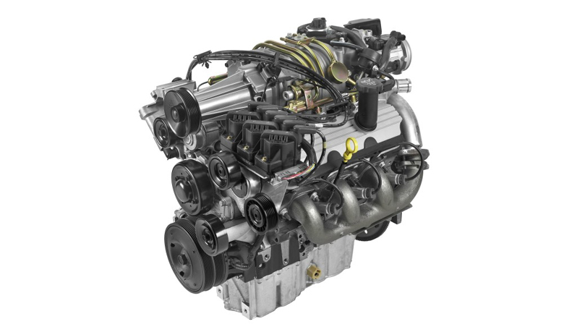
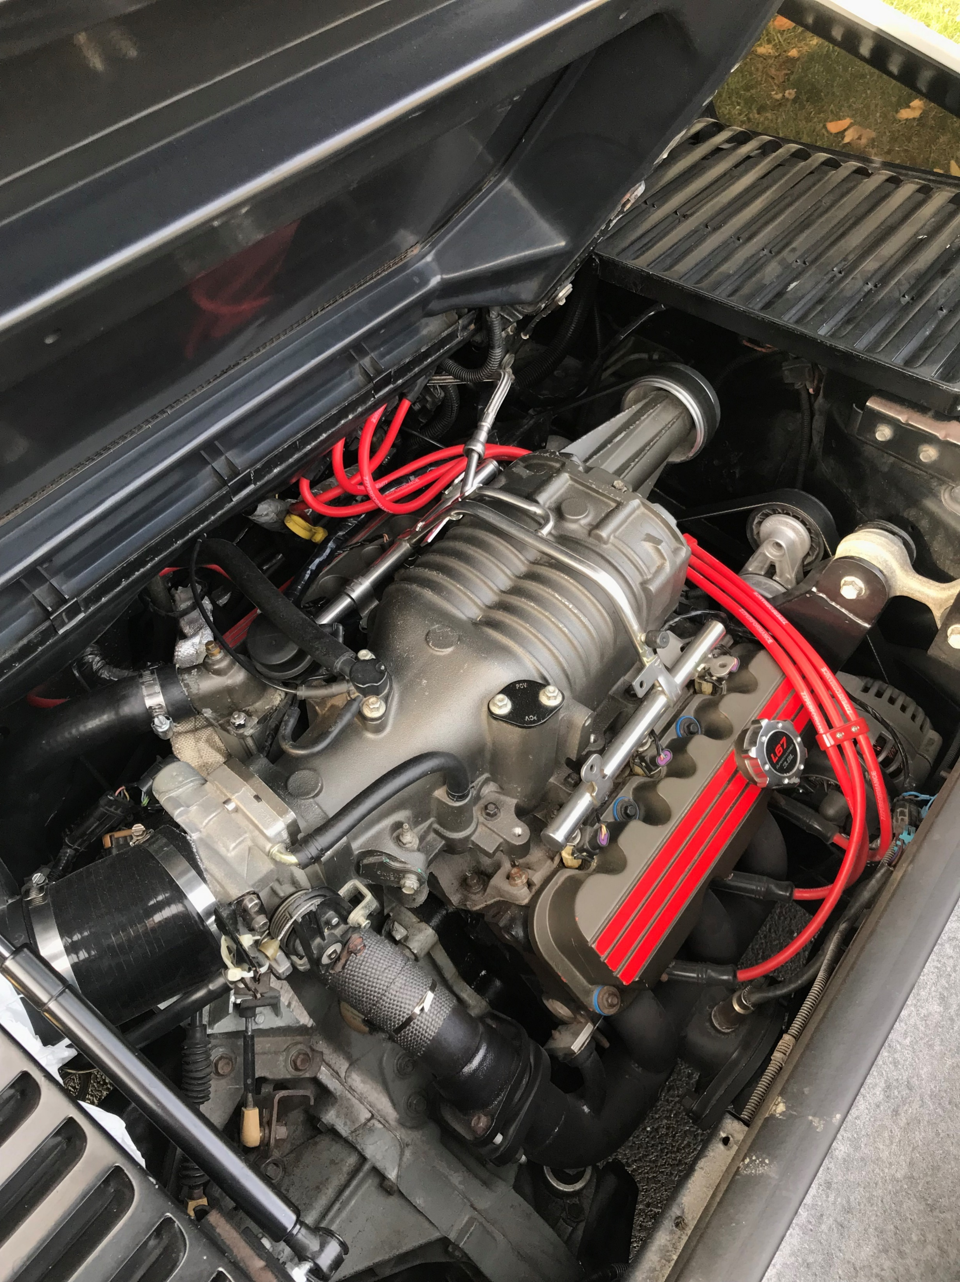
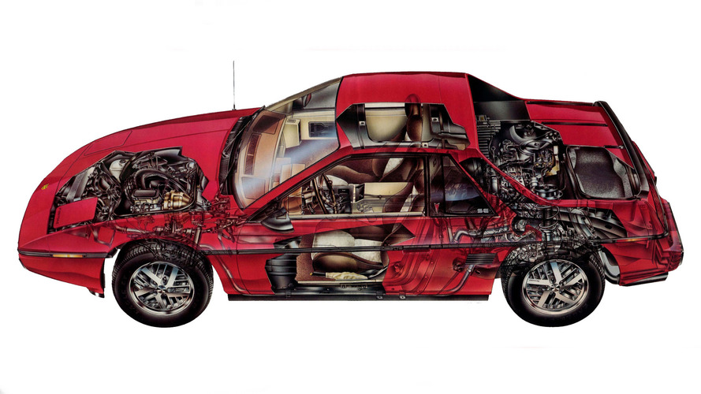
A Guide to 3800 Swap your Fiero
Agenda:
  Why a 3800?
  3800 Engines
    Series I, II, III
  Transmissions
    3800, Fiero & Upgrade
  Engine & Trans Considerations
  Wiring & Electrical
  Fuel Delivery
  Engine Cooling System
  Exhaust
  Air Conditioning

Slide 3
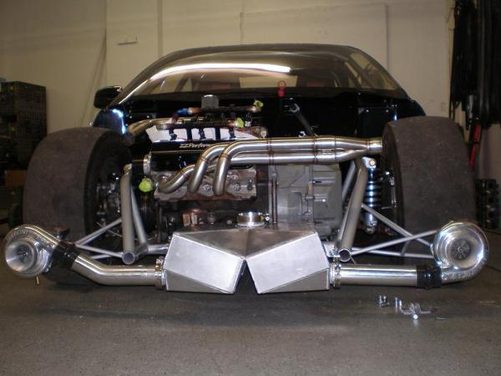
A Guide to 3800 Swap your Fiero
Why a 3800?
  Powerful
  Reliable
  Affordable
  Abundant
  Ease of Swap
ZZP Twin Turbo Drag Car

Slide 4
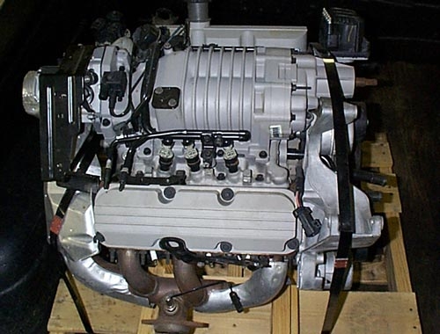
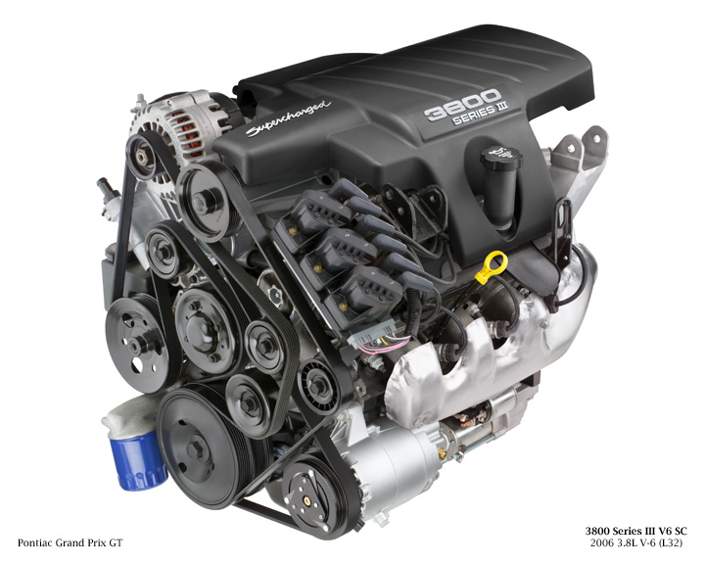
A Guide to 3800 Swap your Fiero
3800 Engines: Series I, II, III
  Series I:
    Introduced early 90’s
    Lowest cost
    Little/no aftermarket support
  Series II:
    Introduced mid 90’s
    Longest build cycle
    Aftermarket support
  Series III:
    Introduced mid 00’s
    Highest stock HP/TQ
    Electronic throttle body
    Returnless fuel system

Slide 5
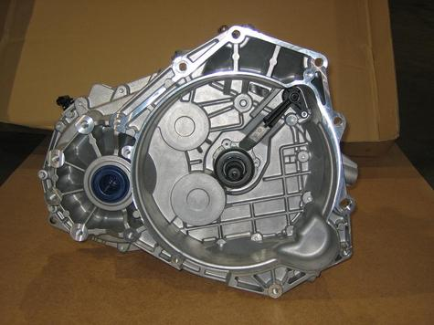
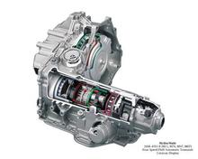
A Guide to 3800 Swap your Fiero
Transmission:
  3800:
    4T60
    4T65E,
    4T65E-HD
  Fiero:
    TH125
    84’ 4spd
    Muncie 4spd
    Isuzu 5spd
    Getrag 5spd
  Transmission Swap:
    F23 from Ecotec
    F40 from Pontiac G6

Slide 6
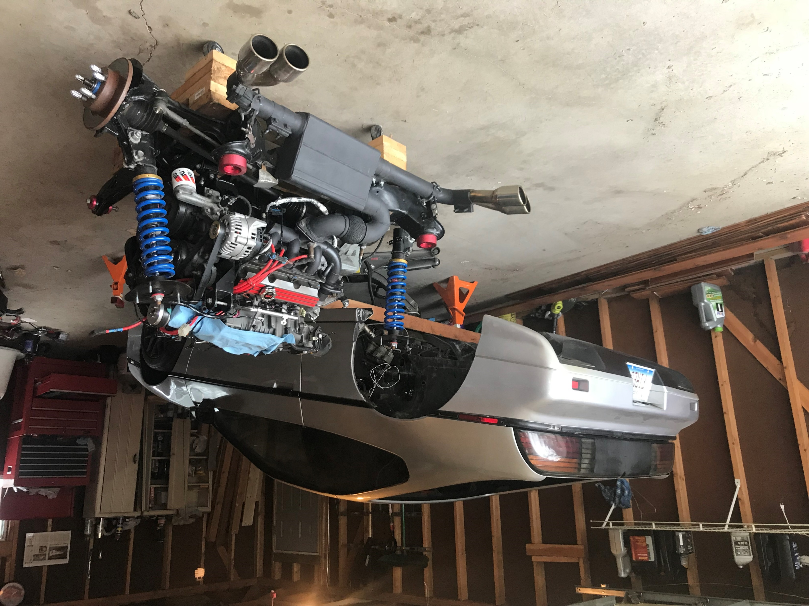
The Swap

Slide 7
A Guide to 3800 Swap your Fiero
Engine & Transmission Considerations:
  Engine:
    Custom mount(s) required
    3800 “dogbone” location
  Automatic Transmission:
    Custom mounts needed
      4T65E-(HD) different patterns
    Hybrid Fiero/3800 axles
    Shift cable adapter

Slide 8
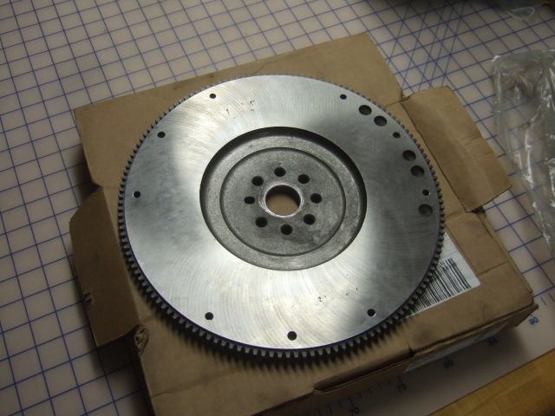
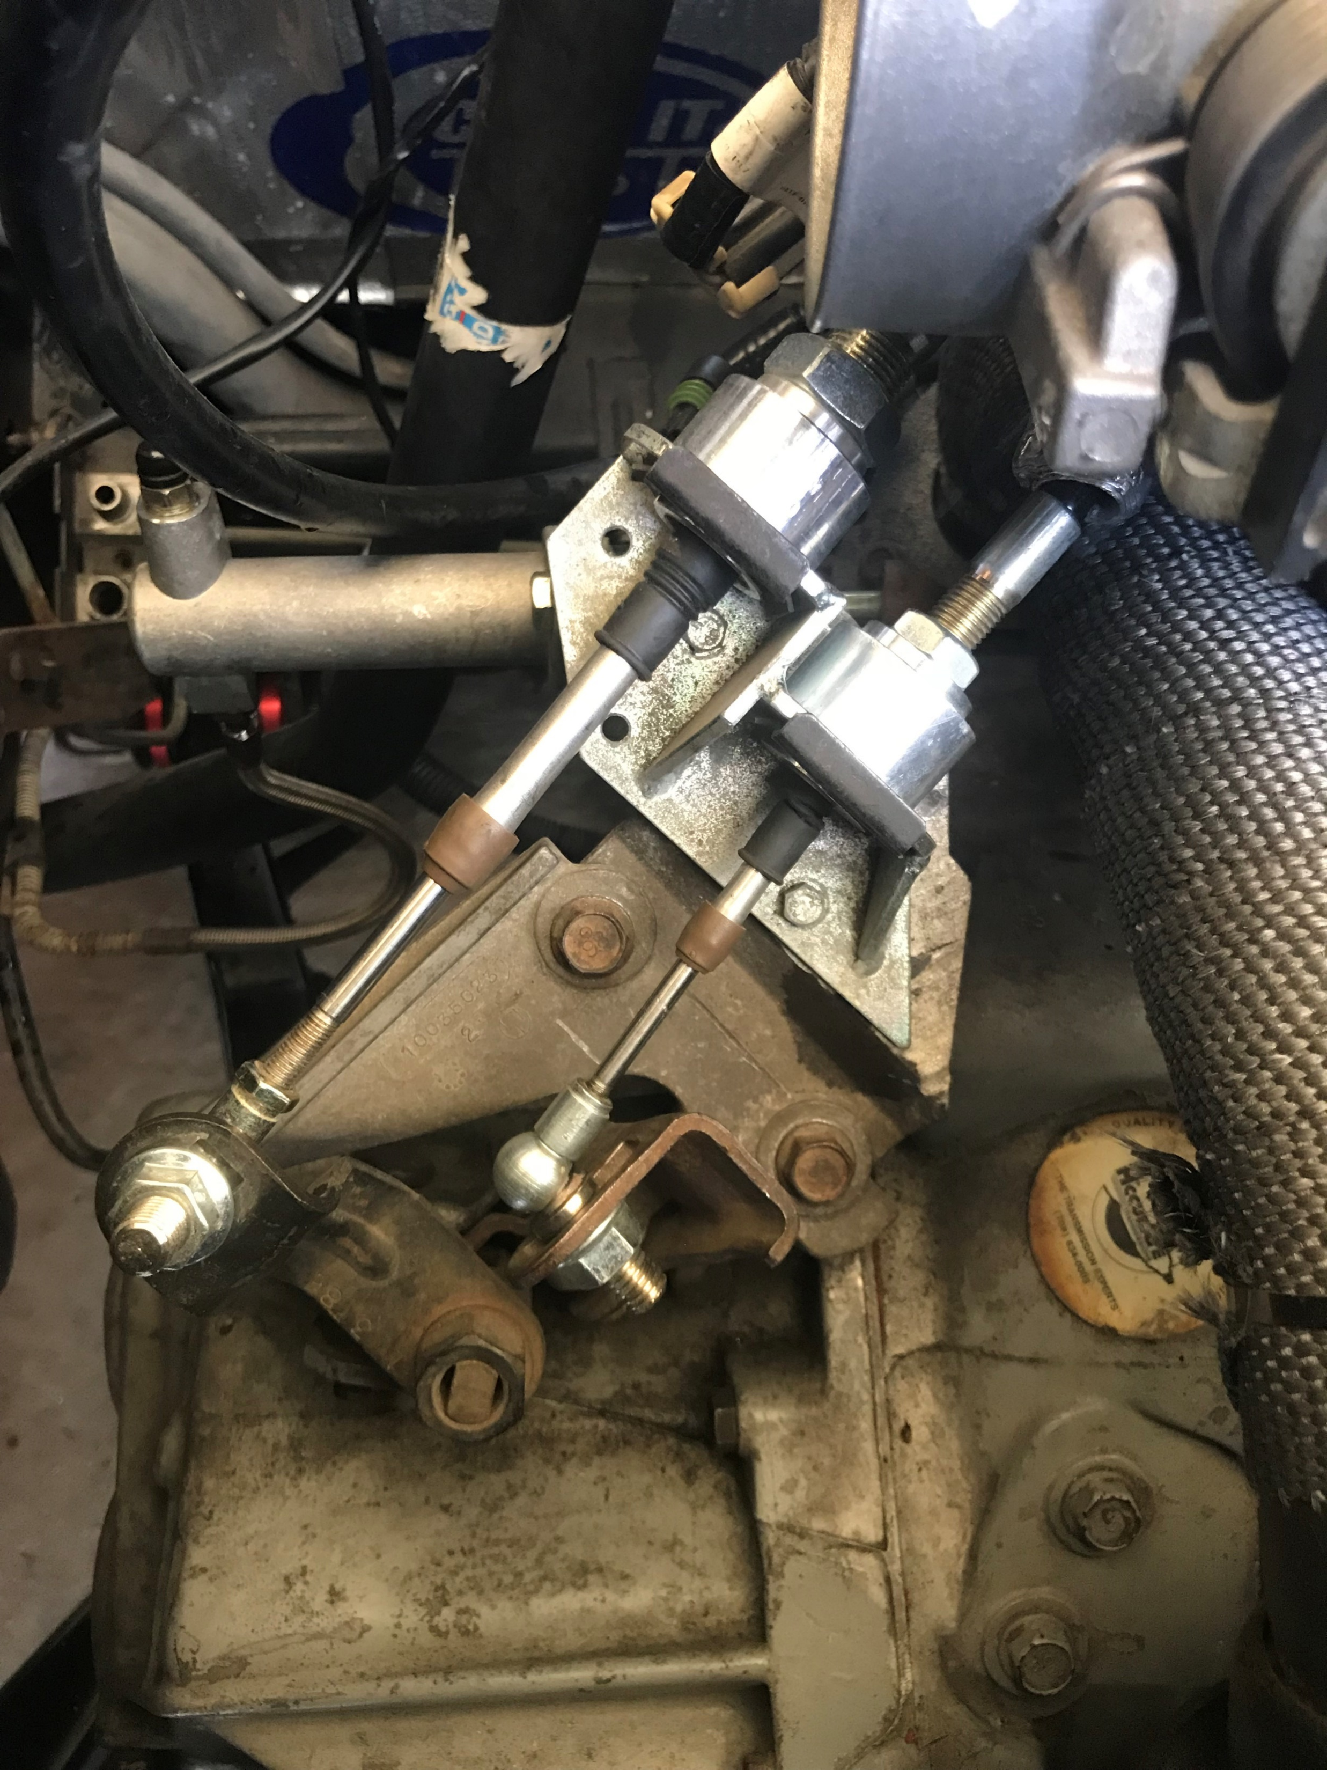
A Guide to 3800 Swap your Fiero
Engine & Transmission Considerations: continued
  Manual Transmission:
    Reuse stock Fiero axles
    Reuse stock mounts
    4spd cable interference
    Fun factor
  Clutch & Flywheel:
    Fiero clutch/pressure plate design
      Upgrade recommended: Clutchnet.com, Spec
    Late 90’s – 00’s 3800 F Body flywheel
        Milled to .840’ thick
        Rebalanced for supercharged engines

Slide 9
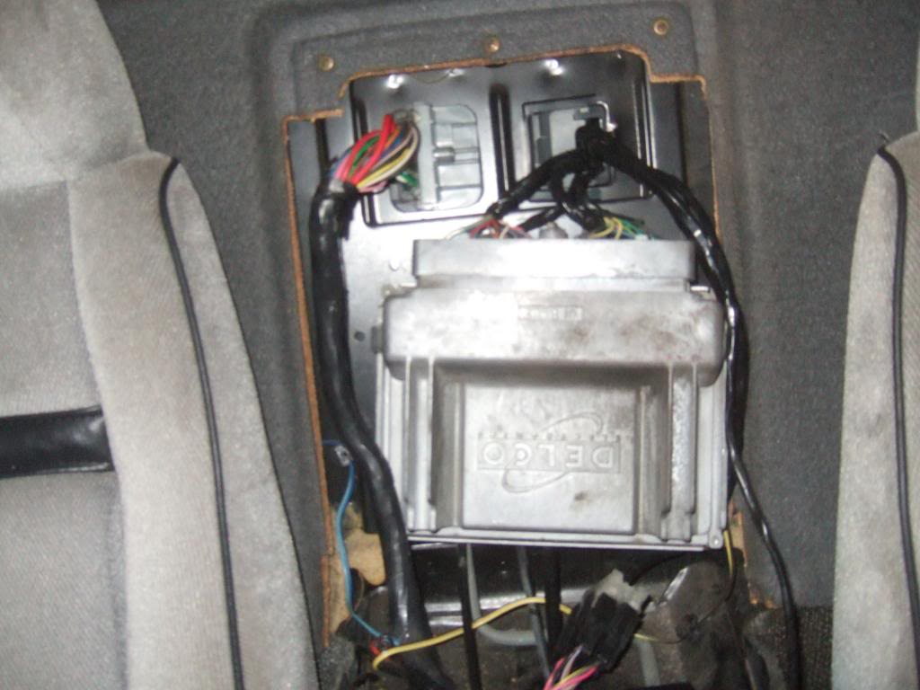
A Guide to 3800 Swap your Fiero
Wiring & Electrical:
  Wiring Harness
    Labor intensive
    Complicated
  Ignition Control Module (ICM) & Packs
  Battery Location
    Stock relocate
    Relocate using 2000’s Park Avenue Battery Cables
  Powertrain Control Module (PCM)
    Vehicle Anti-Theft System
    Emission components
    Diagnostic Trouble Codes (DTC)

Slide 10
A Guide to 3800 Swap your Fiero
Wiring & Electrical: continued
  Series III Engines Electronic Throttle Body
    Replaces traditional cable driven design
    Requires use of Throttle Position Sensor
    Series II throttle body direct bolt-on
  Northstar Throttle Body
    Closely Matches 75mm bore of Gen V S/C
    Better throttle response
    Requires stand-alone Mass Air Flow Sensor (MAF)

Slide 11
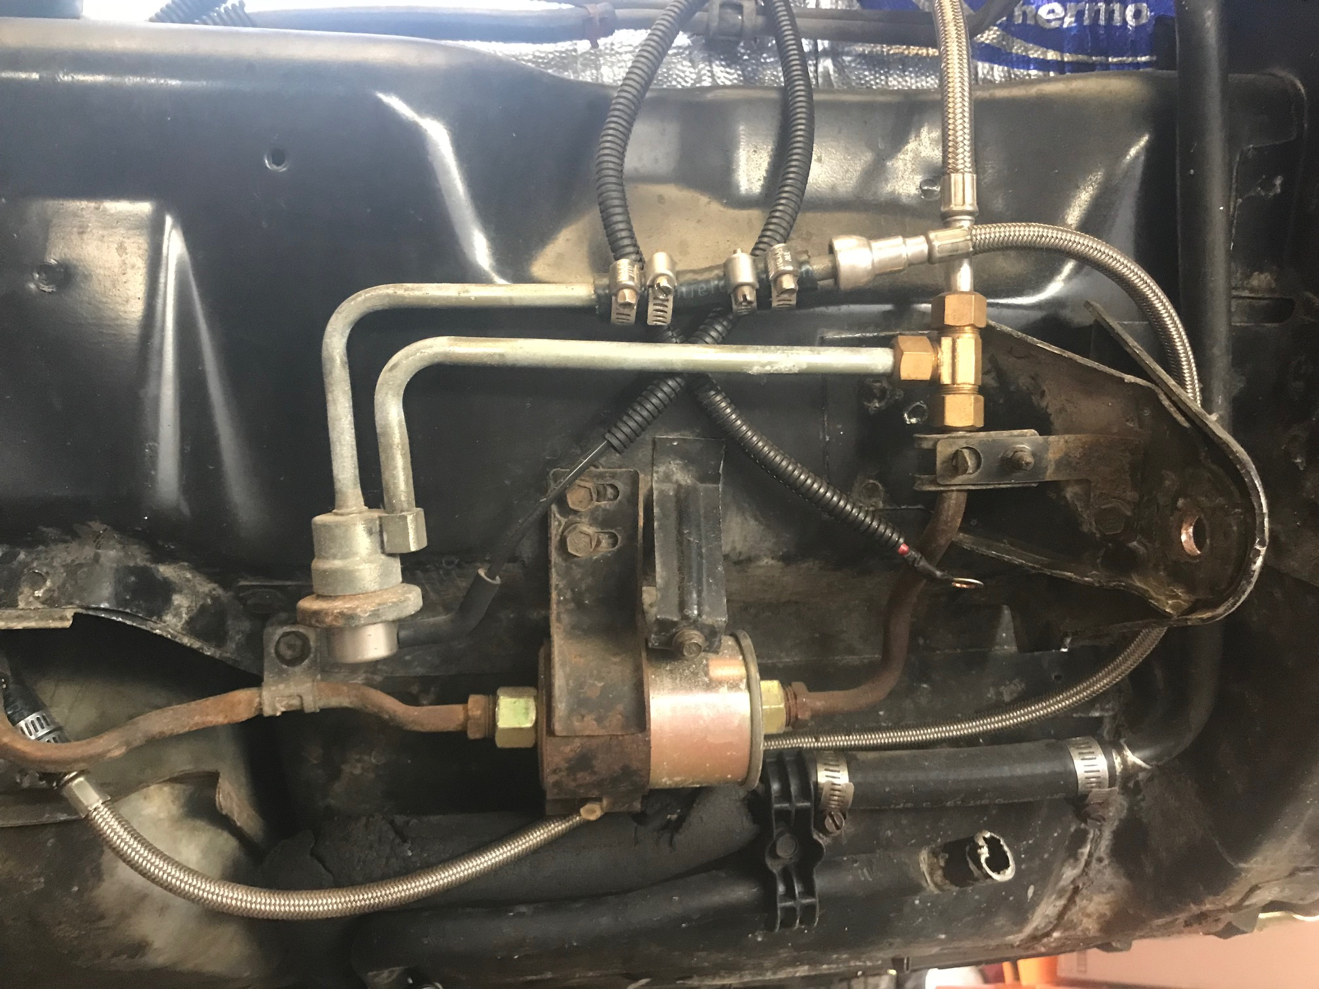
A Guide to 3800 Swap your Fiero
Fuel Delivery:
  Upgrade Fuel Pump
    S/C engines need more powerful pump
    EP 381 from GM SUV
    Specialized pump for E85 fuel
  Fuel Rail: Return vs. Returnless
    Series I & II return design
      Integrated Fuel Pressure Regulator (FPR)
    Series III returnless design
      Requires stand alone FPR
    Aftermarket fuel logs: ZZP

Slide 12
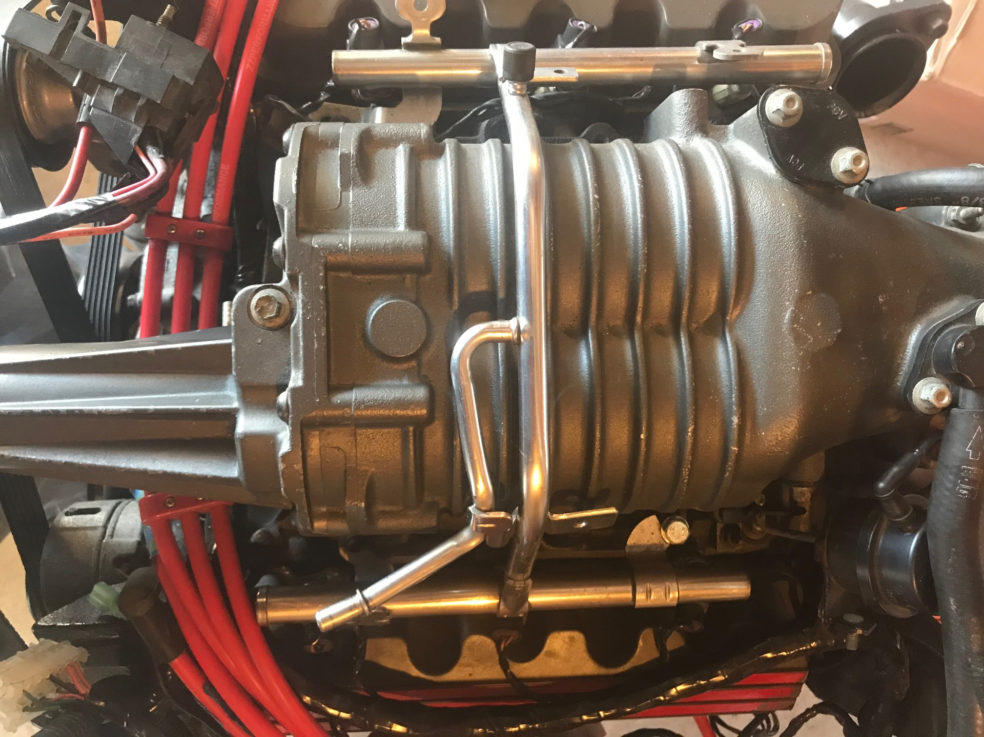
A Guide to 3800 Swap your Fiero
Fuel Delivery:
  Fuel Lines
    3800’s designed for FWD application
    Fuel injection rated hoses
    180* Fuel Rail
    Steel braided fuel lines from GM Van’s w/3800

Slide 13
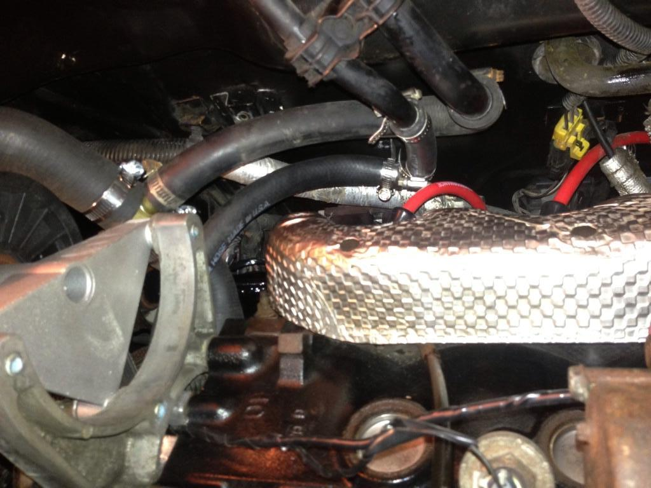
A Guide to 3800 Swap your Fiero
Engine Cooling System:
  Thermostat Housing
    Stock ties into heater core lines
    3800 has built in bleeder valve
  Radiator
    Stock works for most builds
    Upgrade to aftermarket
      Champion 3 Core aluminum
  Heater Core lines
    Different design 84-86 & 87-88
    Use stock 3800 heater core bracket
      Low mount alternator requires additional work

Slide 14
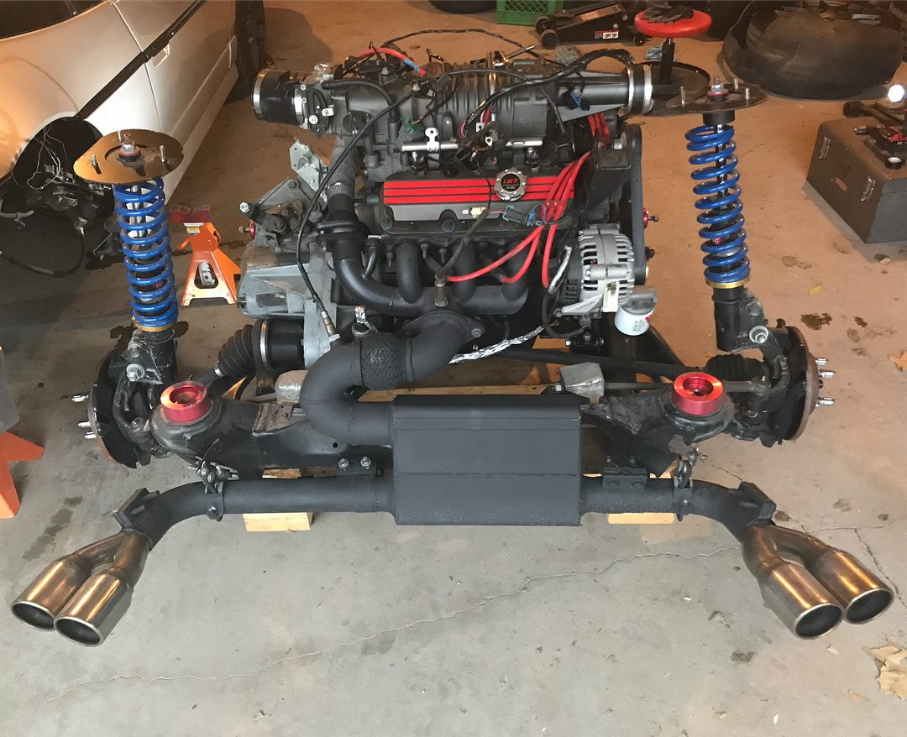
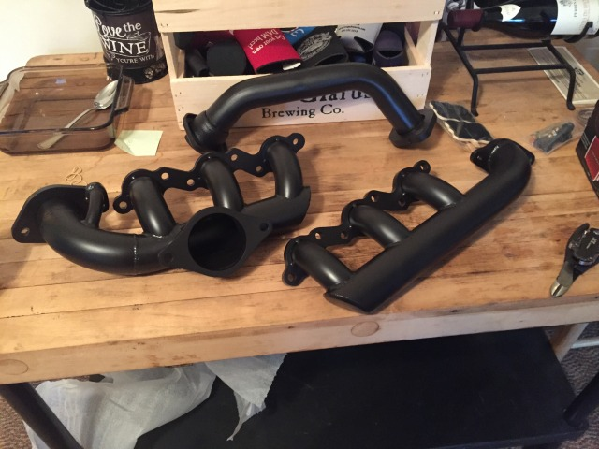
A Guide to 3800 Swap your Fiero
Exhaust:
  Stock Fiero Routing
    Custom crossover pipe and/or exhaust manifolds and piping
  3800 Manifolds “Dump” by Trunk
    To cut the trunk or not
  Performance
    3800 headers
    ZZP “Power Logs”
    Keep pipe diameter in mind

Slide 15
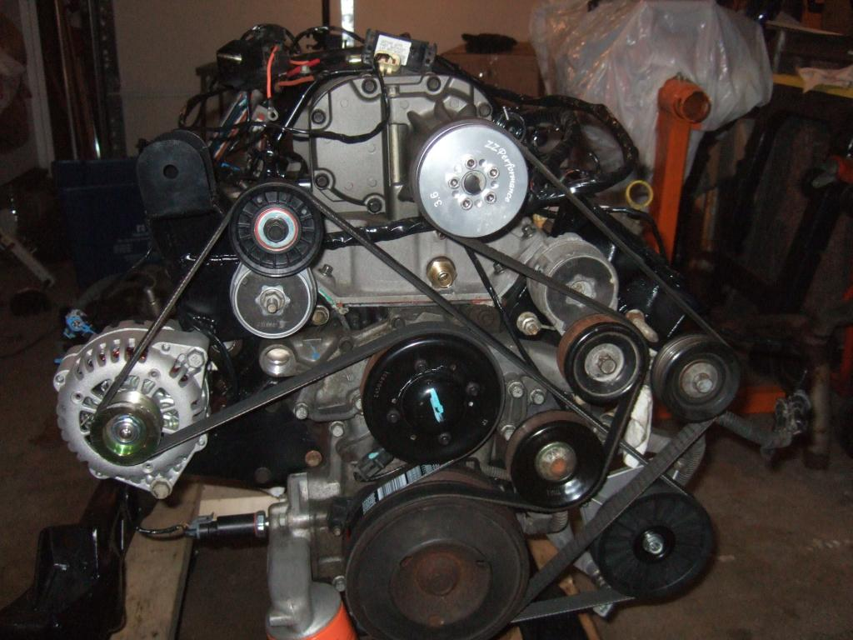
A Guide to 3800 Swap your Fiero
Air Conditioning:
  3800 A/C Compressor
  Custom A/C Hoses
  Upgrade System to R-134 Refrigerant
  Replace Old/Damaged Components
  A/C Delete Pulley
    Easy to bolt on
    Save time/money

Slide 16
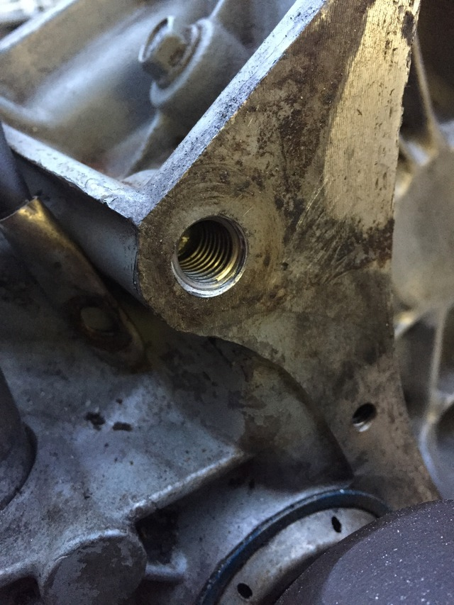
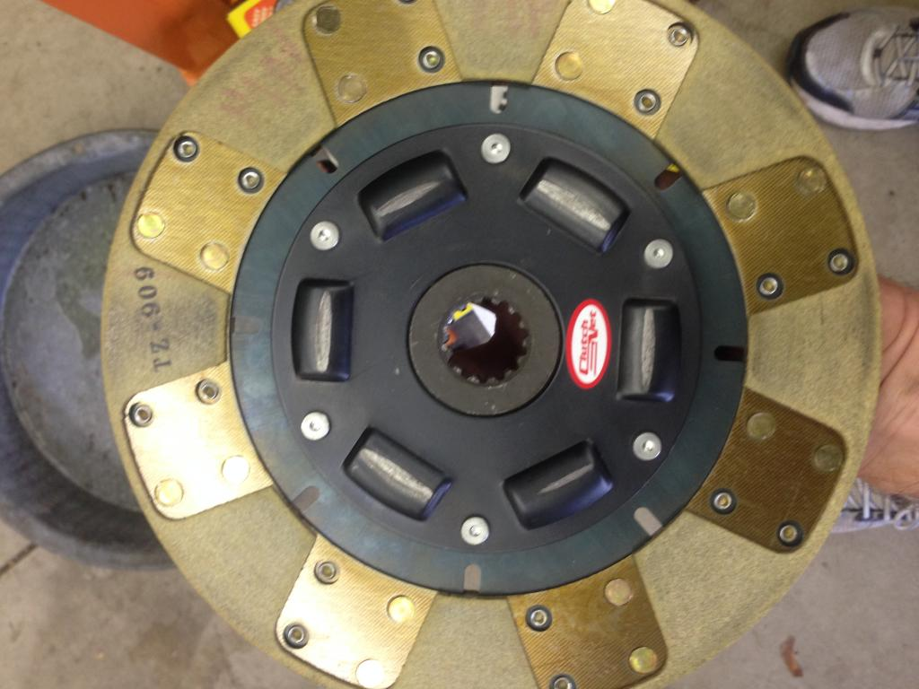
A Guide to 3800 Swap your Fiero
Final Thoughts:
  A Million Ways to go a Mile
  Keep Project Within Scope
  Expect Things to Break
  Worth It In The End

Slide 17
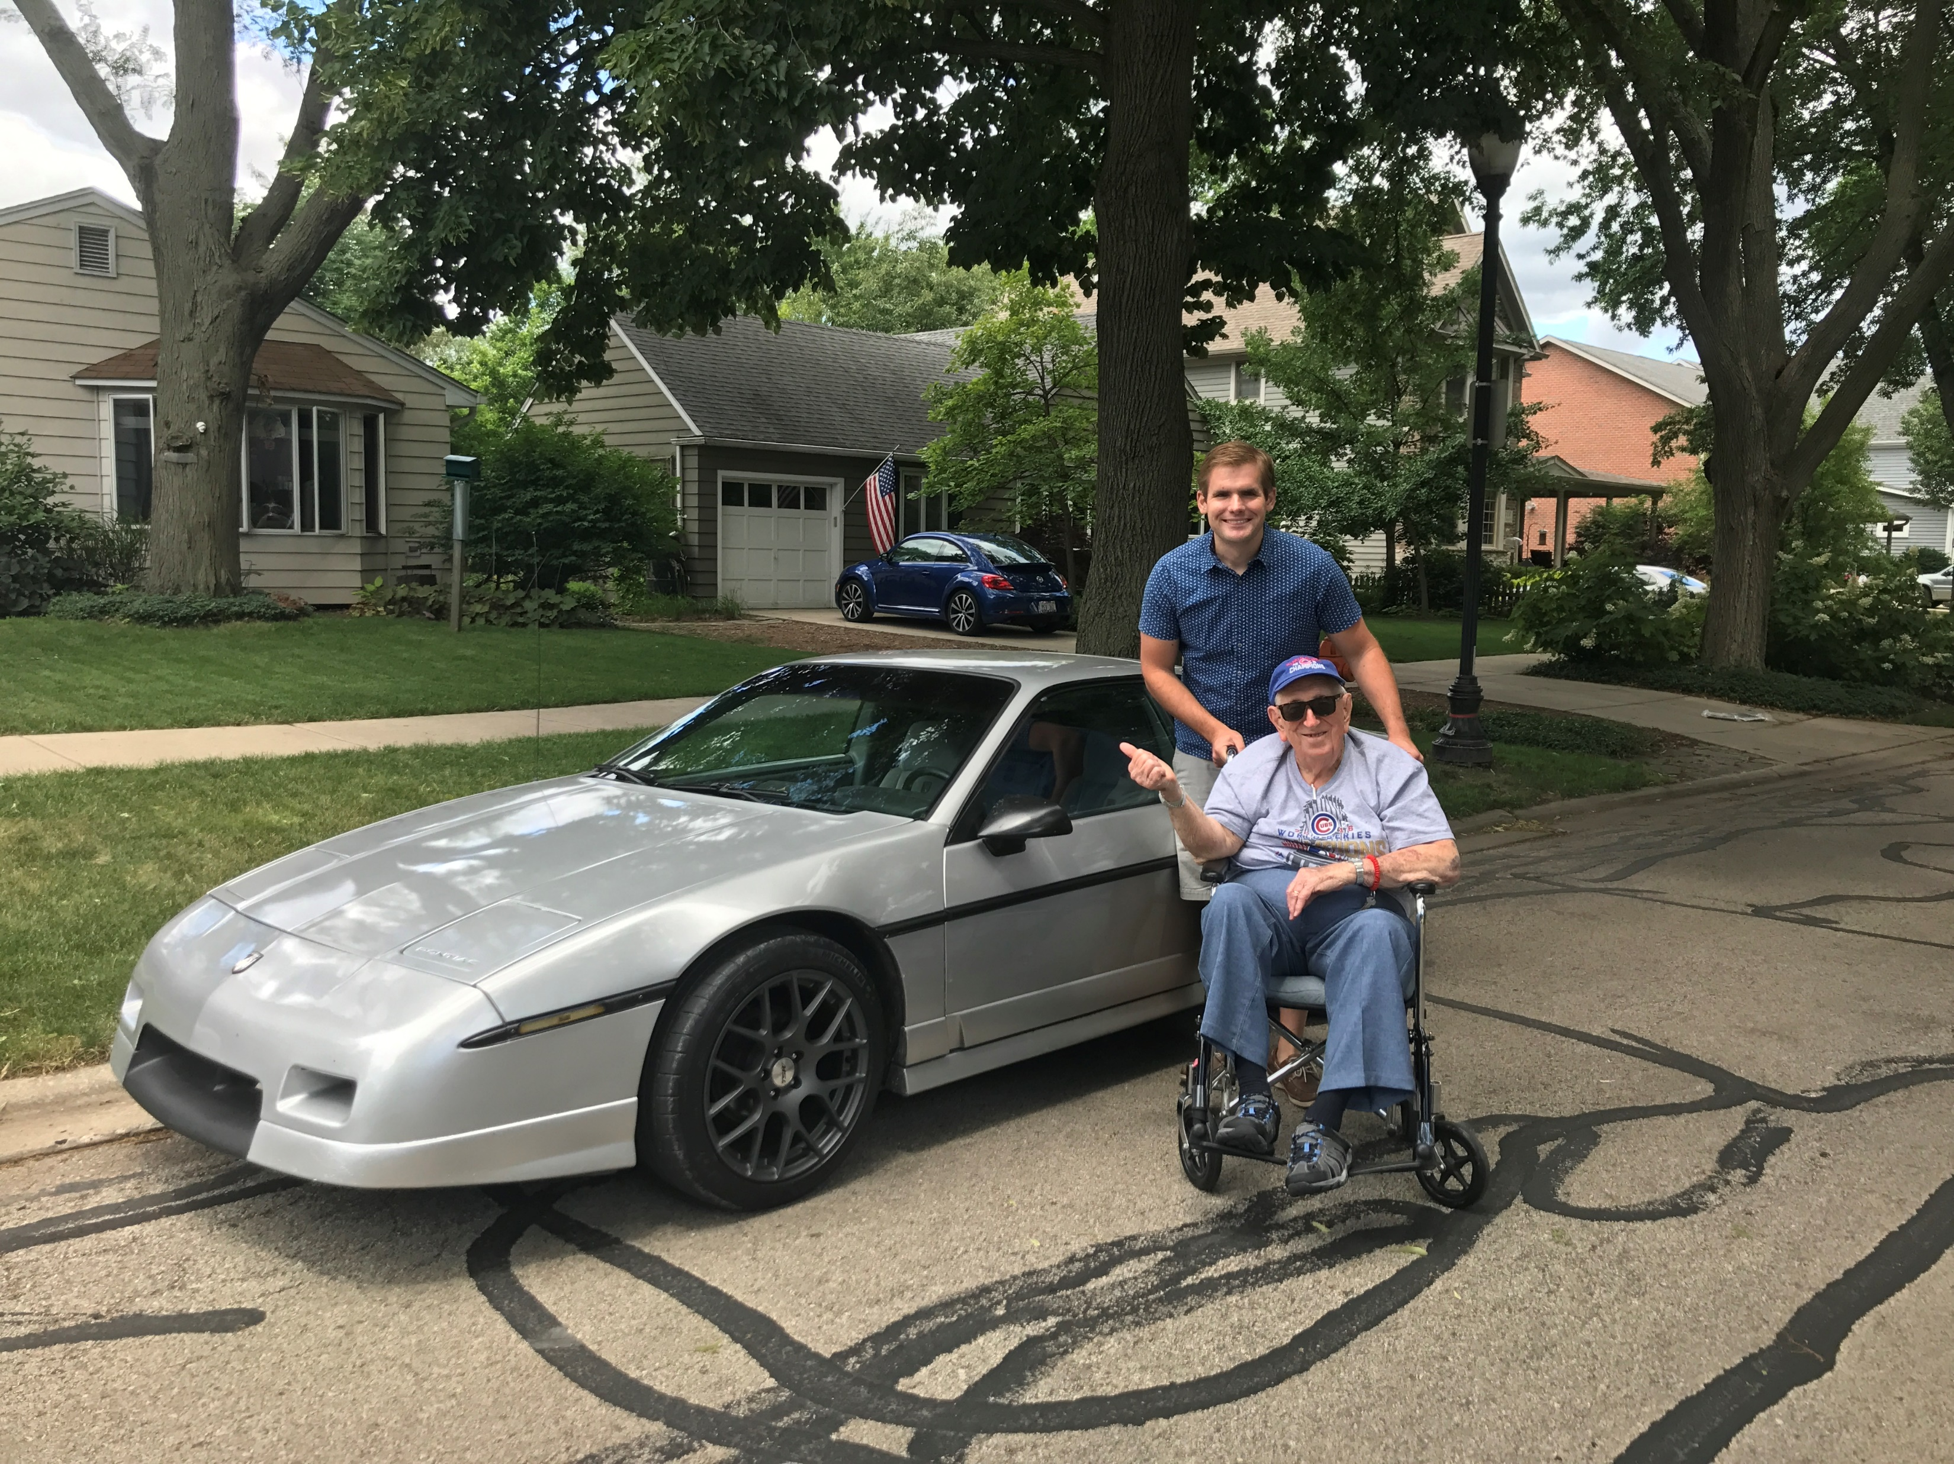
Questions?

